Slide 1

Each of the remaining slides in this presentation has a sound file with additional information. To use this please click on the sound button at the top right hand side of all the slides.
We hope you find this informative.

Slide 2
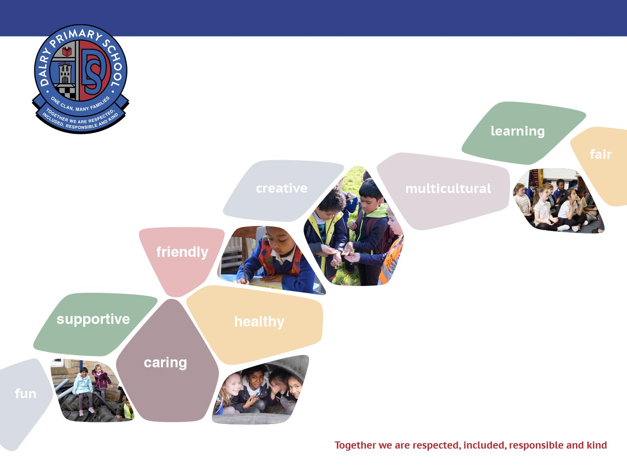


Slide 3
All about us
* Over 300 pupils including the nursery
* Around 70% of our learners have English as an Additional Language in the main school
* Currently have 12 classes and a nursery with a 56 capacity during COVID
* Head Teacher - Elaine Honeyman
* DHT - Vanessa Kelly
* Senior Development Officer - Michaela Mason
* Principal Teacher - Lesley Laidler
* Business Manager - Catherine Smith

Slide 4

All about Dalry
We are a unique place
Community celebrations
Working with parents and carers
Rabbits
Parent Council
Pupil groups

Slide 5

Renewal Plan
Focus on Health and Wellbeing during COVID
Ensuring equity of experience for all our pupils and families
Supporting families with digital devices during lockdown
2021/22 – our focus will be on Literacy, Numeracy, Health and wellbeing and Equalities.

Slide 6

Primary 1 2021/22
Focus on continuous play in P1
Classrooms have been developed to include a standard play provision
Literacy and Numeracy – will be following Edinburgh Literacy Rich and SEAL
Pupils will have a bigger voice and choice in their learning and how this develops in P1
Focus on ensure pupils have a quality outdoor experience during the school day
All pupils will start on Wednesday 18th August start times will be dependant on COVID restrictions, however classes will start at 0900 and finish at 1445 the Wednesday and Thursday of the first week. Packed lunches will be provided
Friday 20th August 0900-12.15pm – packed lunches will be provided
Pupils will commence normal school hours in week 2, this is as follow at the moment -
Monday to Thursday 0840 to 1457, Friday 0840 to 1215. This is due to staggered start and finish times, however this may change in August as restrictions ease.

Slide 7
What happens next?
Next week we will put a virtual information meeting up on the website.
Information on - class teacher, uniform, lunches, what the curriculum looks like and how this will be delivered
Parent Pay – all costs need to be paid online there will be information on what you are required to do to set up and account for your child
Packs will be sent out to all families with additional information
Please contact the school if you have any concerns or questions. The email address is – admin@dalry.edin.sch.uk

